Slide 1

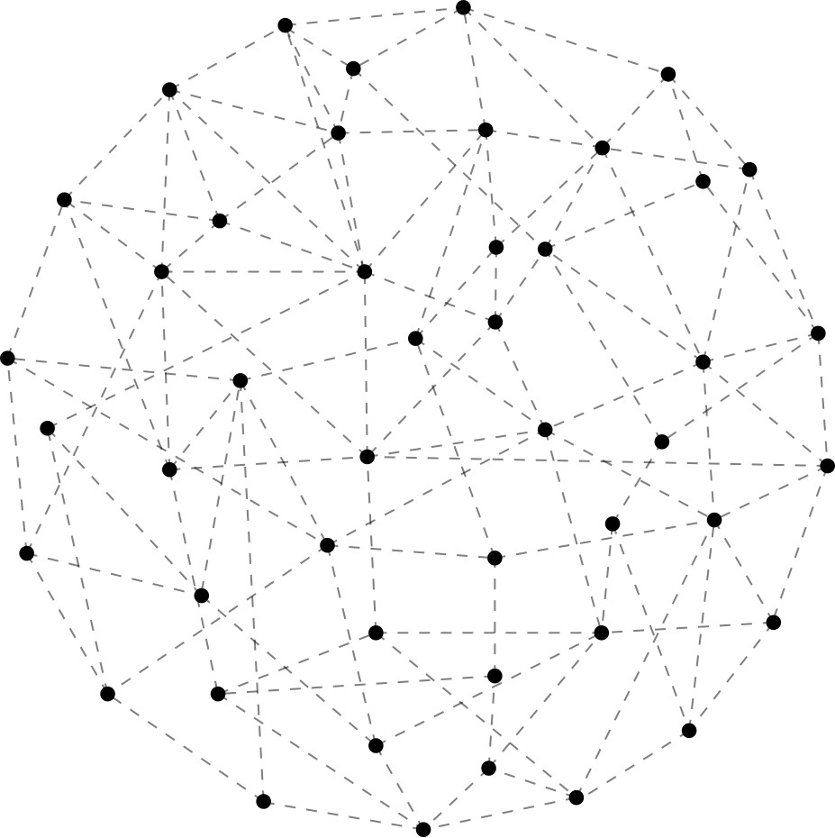



EVENTHUB

Slide 2
GOAL
To build a simple event planning platform that allows users to create and store event details using HTML ,CSS and MongoDB, demonstrating how big data technologies can manage and organize event-related information efficiently.

Slide 3
HOW IT WORKS
1. User Signup/Login
🔹 Users register or log in to access their dashboard.
2. Event Dashboard
🔹 After logging in, users can view events they've created or participated in.
3. Create Event
🔹 Users can add new events by providing title, date, location, and description.
4. Participate in Events
🔹 Users can view available events created by others and join them.
5. MongoDB Integration
🔹 All event data and user information are stored in MongoDB for scalability and fast retrieval.

Slide 4
TECHNOLOGIES USED
Frontend:
🔹 HTML – Structure
🔹 CSS – Styling
🔹 JavaScript – Interactivity
Database:
🔹 MongoDB – NoSQL database to store users and events

Slide 5
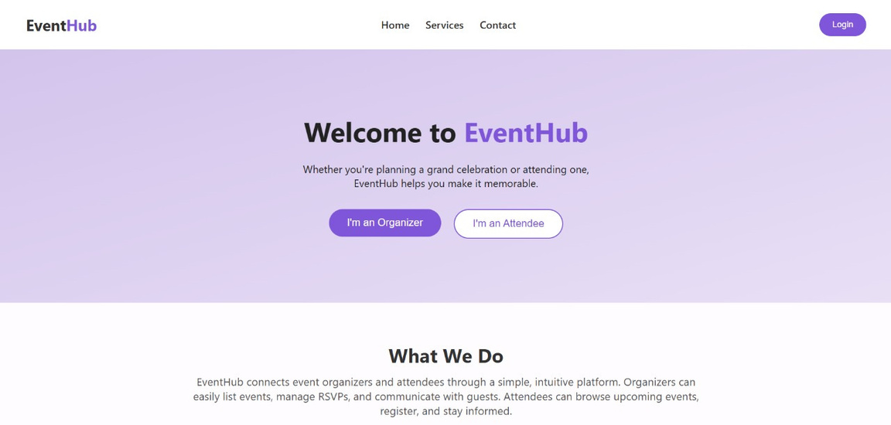
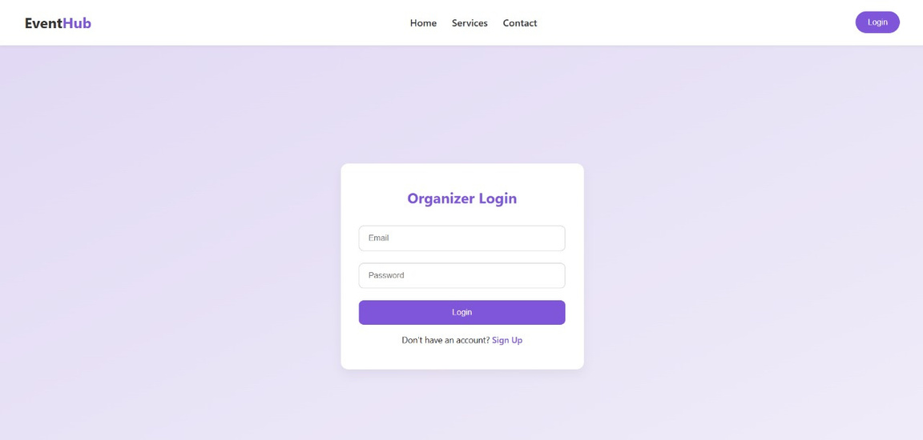
SCREENSHOTS

Slide 6
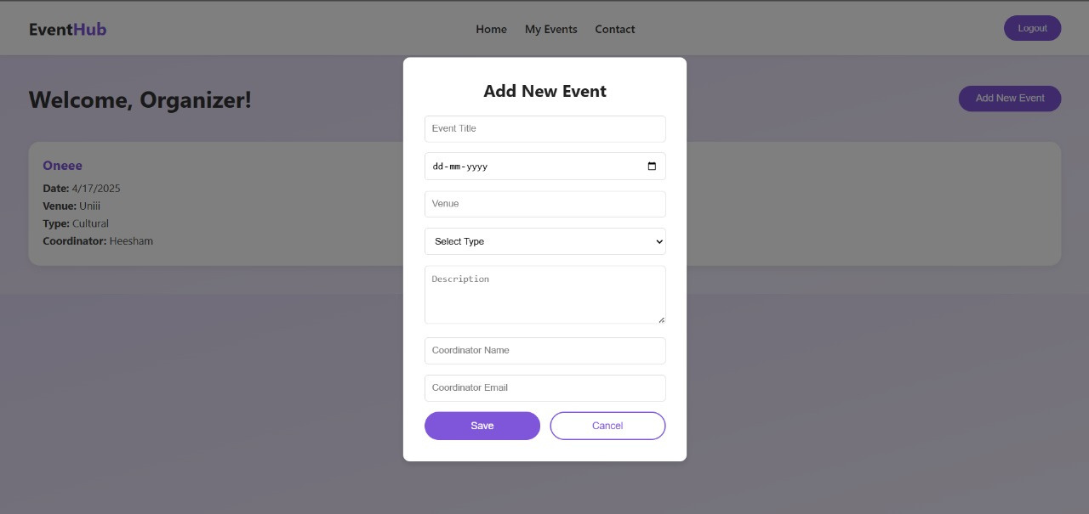
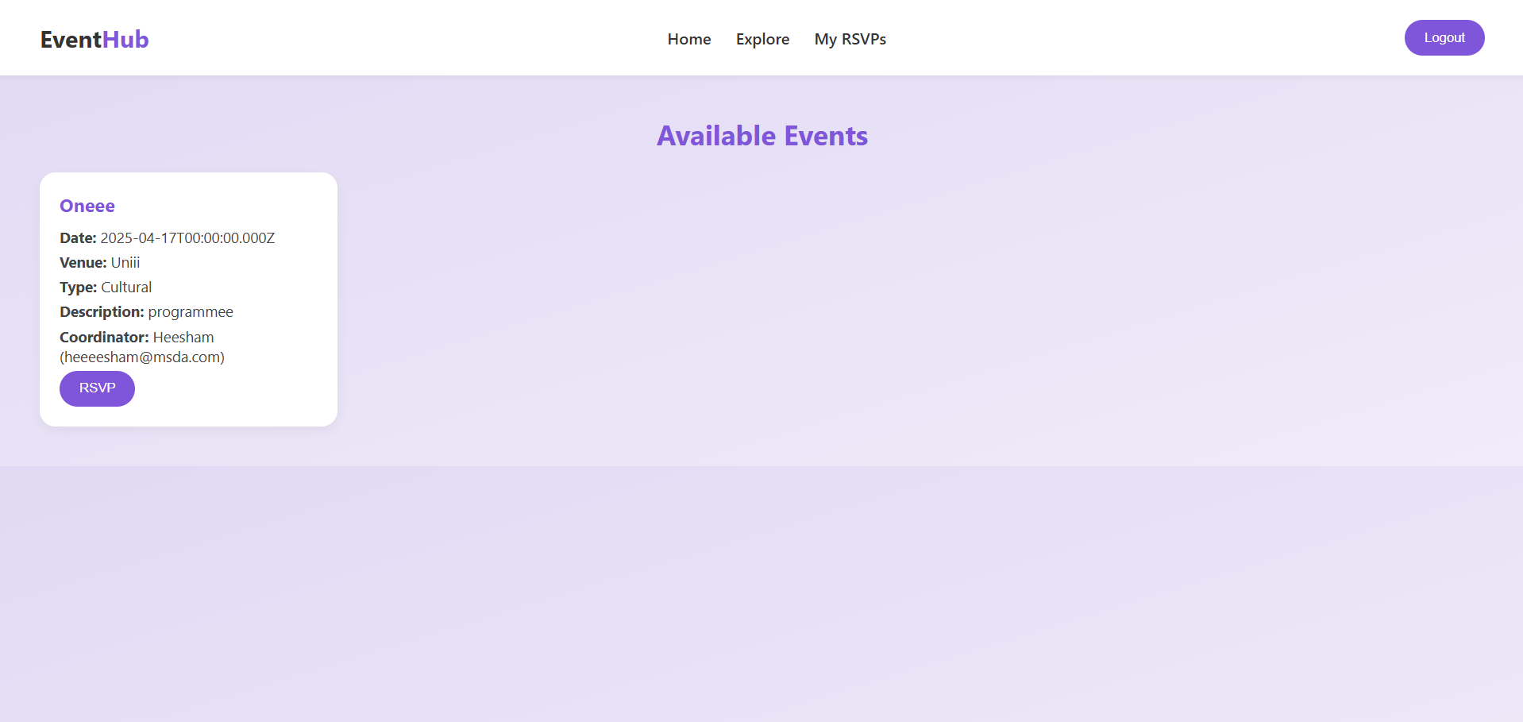
SCREENSHOTS

Slide 7
THANK YOU

